Slide 1
ELEMENTARY STATISTICS, BLUMAN
TI Graphing Calculator - Find Confidence Interval
© 2019 McGraw-Hill Education. All rights reserved. Authorized only for instructor use in the classroom. No reproduction or further distribution permitted without the prior written consent of McGraw-Hill Education.

Slide 2
Objectives for this PowerPoint
How to calculate confidence interval endpoints for the estimation of the population mean using the TI Graphing Calculator
Learn how to use the interval endpoints to calculate the margin of error

Slide 3
Problem
Cost of Room and Board is USD
11760 | 10880 | 8802 | 11406 | 11182
6280 | 7930 | 20350 | 10833 | 25310
10300 | 11498 | 8948 | 6900 | 8064
12860 | 7942 | 7501 | 11529 | 11175
11522 | 7400 | 7164 | 11295 | 7968
Source: The World Almanac
The table shows the cost in U.S. dollars of room and board at a random sample of 25 U.S. colleges and universities in the year 2016.

Slide 4
TI Graphing Calculator (1)
We'll use the TI graphing calculator to find the interval endpoints for the 95% confidence interval for the actual mean cost of room and a at U.S. colleges and universities for the year 2016.
We will then use the interval endpoints to calculate the margin of error.
In order to use the TI graphing calculator to find the interval endpoints for a confidence interval estimate of a mean when we have data.

Slide 5
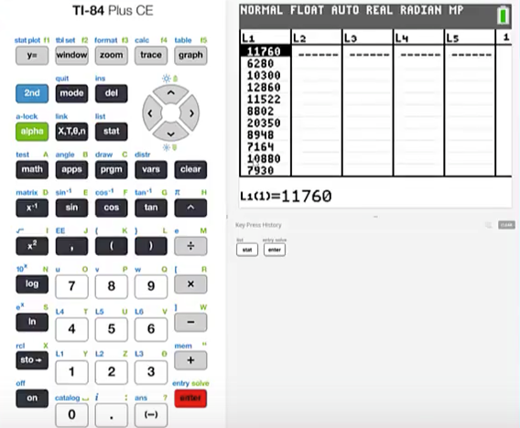
TI Graphing Calculator (2)
Press stat and then press 1 to edit a list and enter the data values into the list. Enter a data value and press enter.
Continue until you have entered all of the values.

Slide 6
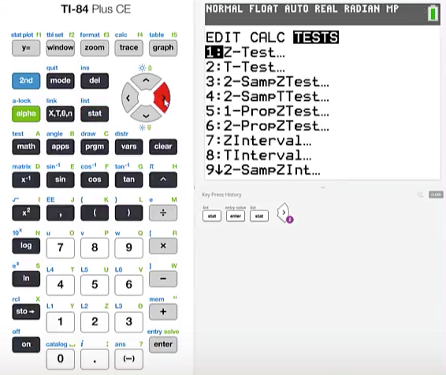
TI Graphing Calculator (3)
To find the interval endpoints
Press stat
Cursor over to TESTS

Slide 7
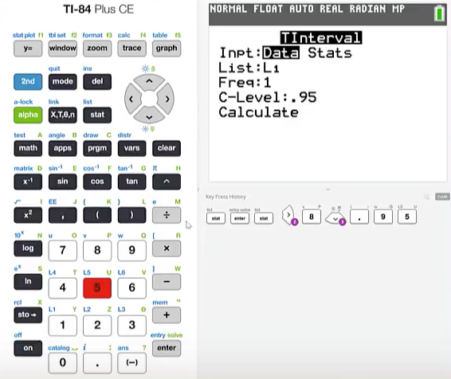
TI Graphing Calculator (4)
Choose T interval which is number 8. We will choose T interval, since the population standard deviation is not known.
Highlight Data - Make sure that the correct list is specified. We have our data values in List 1.
Cursor down
Confidence Level is .95
Press Calculate

Slide 8
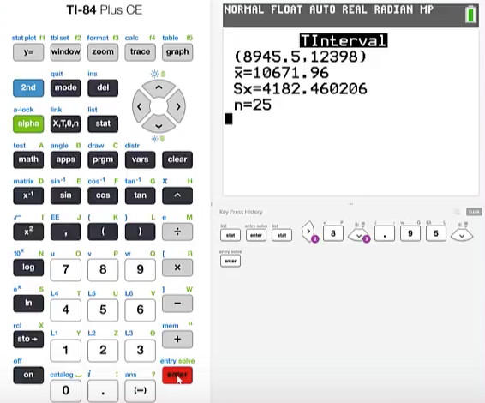
TI Graphing Calculator (5)
We have the interval endpoints $8945.50 up to $12398.00.
Note also that the sample mean of $10671.96 is given.
Also note that the sample standard deviation is given.

Slide 9
Interpretation
So our interpretation of the interval would be, it can be stated with 95% confidence that the academic year 2016 mean cost of room and board in U.S. colleges and universities is between $8,945.50 and $12,398.00.
Recall that a confidence interval is constructed by beginning with the point estimator, then add the margin of error to find the right endpoint and then subtract the margin of error to find the left endpoint. So the margin of error can be determined by dividing the interval width by 2.

Slide 10
Calculate Margin of Error
We can calculate the margin of error for this interval by subtracting the left endpoint from the right endpoint and then dividing by 2. This gives us a margin of error of $1726.25.
So with 95% confidence our estimate is within $1726.25 of the true mean.

Slide 11
Summary
In this PowerPoint, we learned how to calculate confidence interval endpoints for the estimation of the population mean using the TI Graphing Calculator and we learned how to use the interval endpoints to calculate the margin of error.

